Slide 1
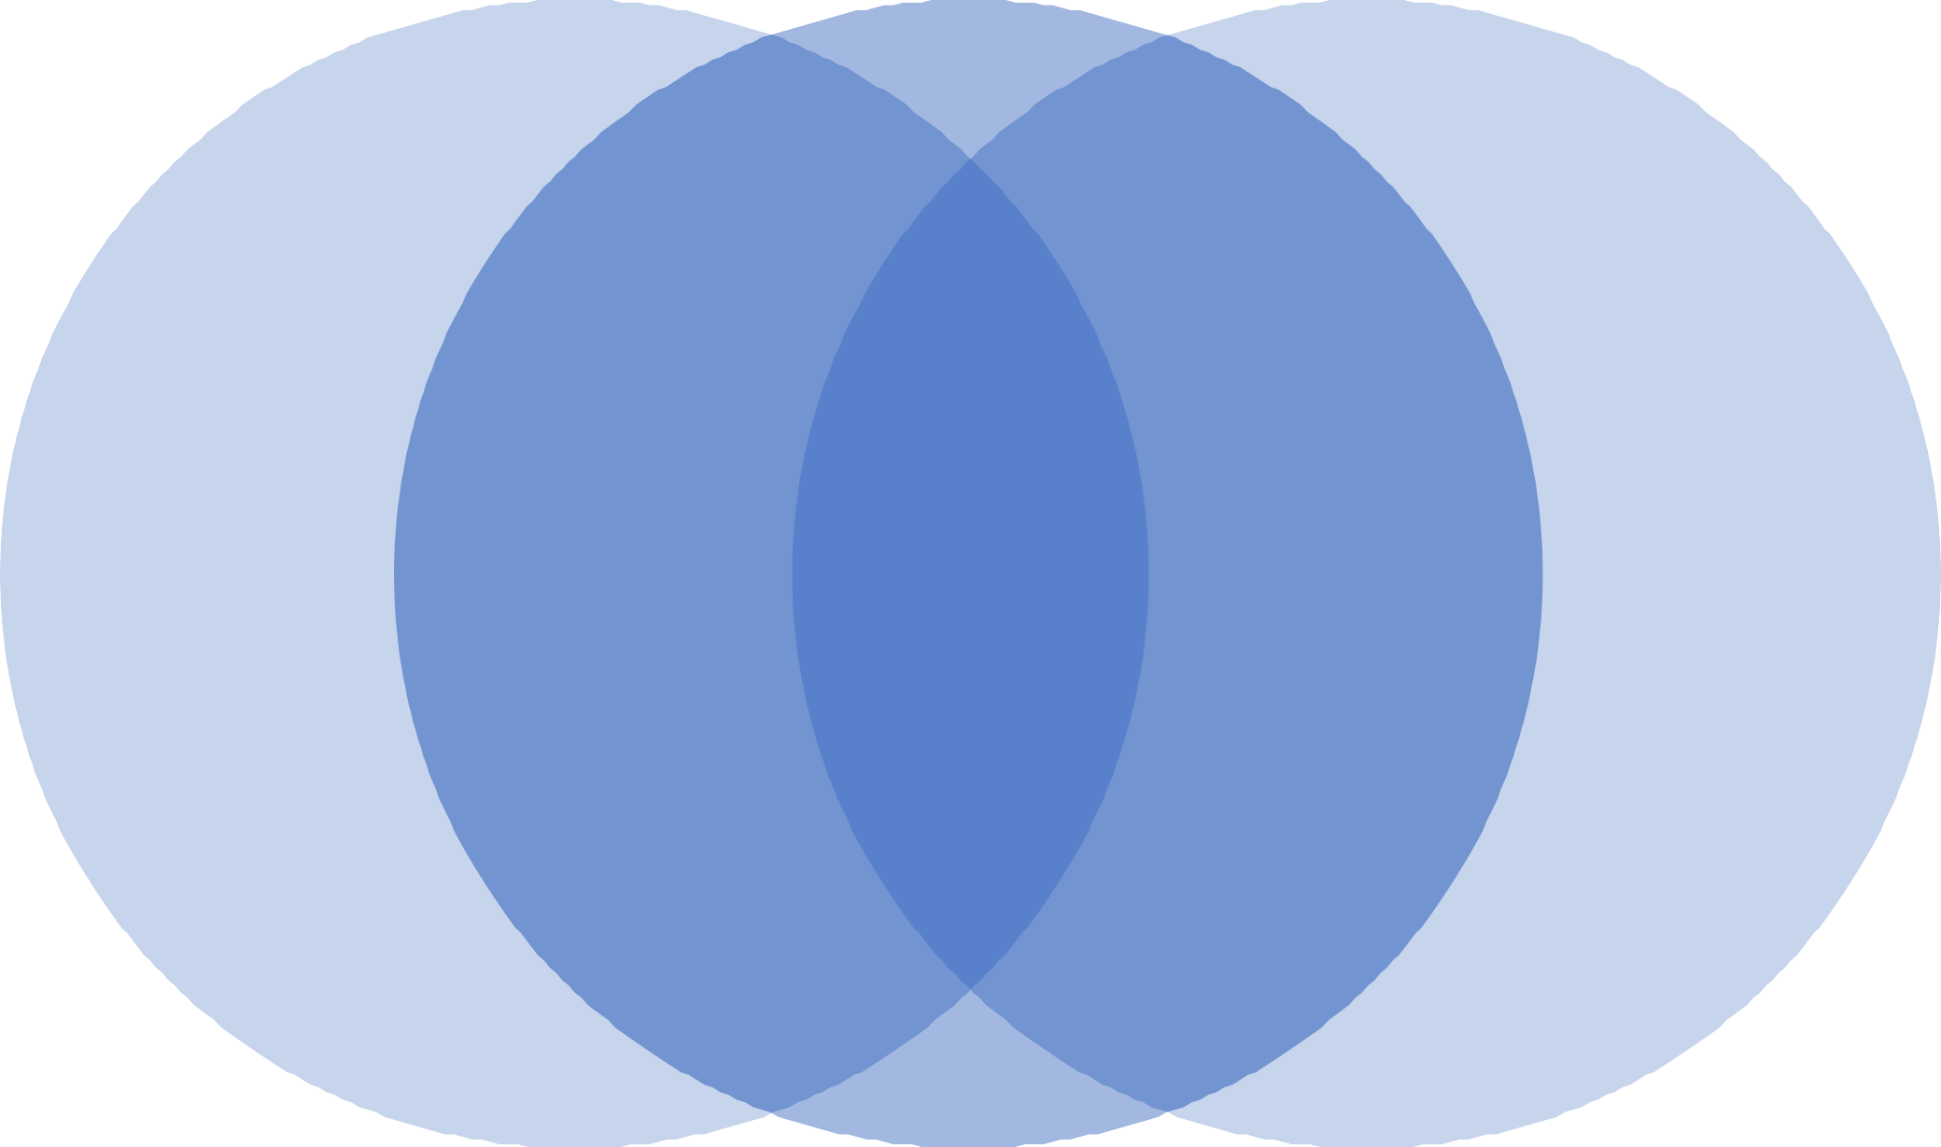
Port of Wilmington Expansion / DuPont Edgemoor Brownfield Property
Presentation by Delaware Community Benefits Agreement Coalition
Community Action Meeting
March 8, 2022

Slide 2
The Delaware CBA Coalition, Inc.
Member Organizations:
  Banking Desert Initiative
  Collins Park Civic Association
  Delaware Africa Coalition
  Edgemoor Revitalization Cooperative, Inc.
  New Castle Prevention Coalition
  Southbridge Civic Association
  Rosehill Garden Civic Association
  Sierra Club, Delaware Chapter
  Network Delaware
Who We Are
The Delaware Community Benefits Agreement Coalition, Inc. (DCBAC), formed January 2017, is comprised of a diverse cross-section of the Delaware community. Members and allies include local residents, civil rights organizations, labor organizations, community-based organizations, faith-based organizations, small businesses, civic associations, and environmental groups, among others.
2017
DCBAC Officers
  Chairperson–Jeffrey Richardson
  Vice Chair–Marie Reed
  Secretary – Mujahid Nyahuma; Assistant, Carlos Dipres
  Treasurer– Jeanette Swain; Assistant, Sandra Smithers

Slide 3
WHAT WE DO?
The Coalition was principally formed in order to develop the terms and to oversee implementation and compliance for a Community Benefits Agreement framework that prioritizes community, economic and environmental health and sustainability. It is the only community-based
coalition of its kind in the State and is committed to addressing the community’s needs and concerns related to the economic/community development process, racial inequality and the environment.
A “community benefits agreement(CBA)” is a legally binding tool that outlines the terms of an agreement between a developer and a broad community coalition that proactively identifies potential issues associated with a project, along with mitigation plans and benefits to the community.
CBA Benefits
Win-Win / Community Buy in
Jobs/training
Mitigation input
Environmental and social justice; inclusion

Slide 4
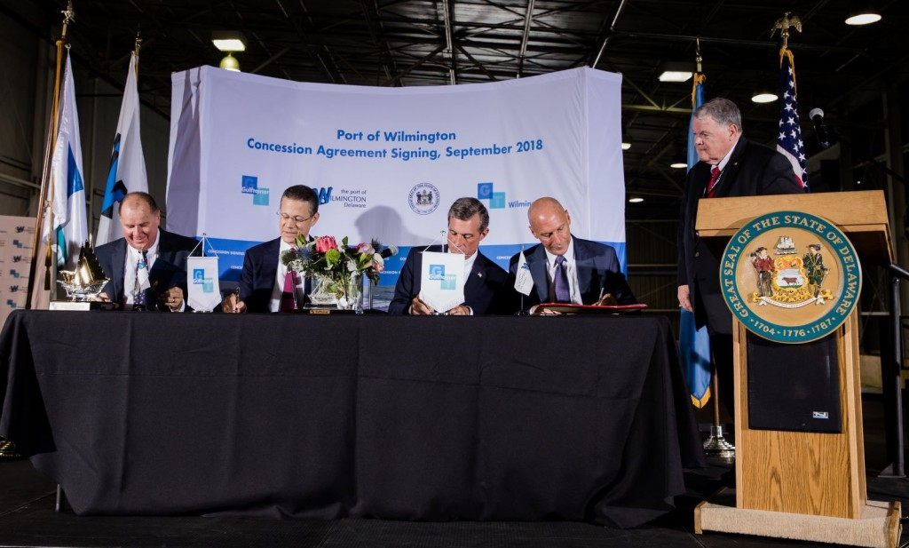
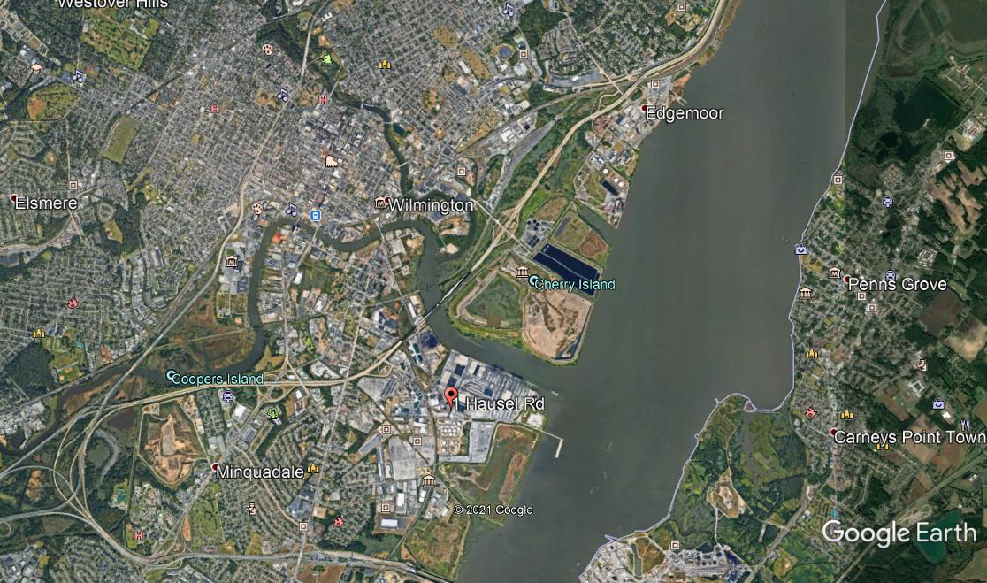
DCBAC AND THE PORT OF WILMINGTON EXPANSION
GULFTAINER SIGNS 50-YEAR, $600 MILLION CONCESSION TO OPERATE AND EXPAND PORT OF
WILMINGTON IN DELAWARE, USA 19 Sep 2018
Source: https://www.gulftainer.com/press-release/gulftainer-signs-50-year-600-million-concession-to-operate-and-expand-port-of-wilmington-in-delaware-usa
.
OUR PORT INITIATIVE GOALS
Secure a binding Community Benefits Agreement from Diamond State Port Corporation and associated entities, developed with DCBAC and its impacted community residents.
Win protections from potential health and environmental dangers as well as safeguards against the displacement of existing residents due to port-related land use issues, in advance of permit approvals.
Establish an inclusive port development/planning process.
Get additional Public Hearings and Public Meetings on the port expansion.

Slide 5
COMMUNITY CONTEXT
Many members of the communities near and around the port have experienced years of under and disinvestment. We are therefore interested in development, as long as it does not cause harm to the health and wellbeing of citizens or the environment, is conducted in a transparent manner and deeply engages local residents as partners in the port expansion.
The disproportionate and unchecked siting of polluting facilities in and near people of color and low-income communities is well-documented. Black communities near the port already suffer from high rates of cancer, and respiratory ailments. These pre-existing conditions have resulted in higher death rates during this Coronavirus Pandemic. The result of this environmental racism is that Black communities have often been used as Sacrifice Zones.
Source: DCBAC public comments to Delaware Natural Resources and Environmental Control (DNREC) on Port expansion and presentations by entities seeking permits
.

Slide 6
Permitting and Approvals:
Federal Consistency Certification-Delaware Coastal Management Program
State of Delaware Subaqueous Lands Permit (We have appealed this.)
Clean Water Act Section 401 Water Quality Certification
The proposed project supports the redevelopment of the Edgemoor Site into a multi-user containerized cargo port. The primary harbor access channel will provide access to an approximately 2,600 foot long wharf structure. The berth and access channel will be excavated to the 45-foot mean lower low water (MLLW) project depth. At the riverward edge of the wharf the future river bottom will be shaped to slope upward to a quay wall along the landside of the wharf. The quay wall will support the elevation transition from the river bottom to the grade of land within the new port. The 45-foot MLLW project depth matches the maintained depth of the Federal navigation channel.
“sediments that contain hazardous substances, such as aromatic hydrocarbons (PAHs), metals, dioxins and furans and polychlorinated biphenyls (PCBs). PCBs are of particular concern in the Delaware River due to their bio-accumulating properties, chemical stability, and environmental toxicity. Potential PCB removal will be assessed for each alternative.”
Source: Edgemoor Environmental Assessment
.
- 3.3 million cubic yards of dredging
- Extensive shoreline habitat loss
- Significant subaqueous impacts
- No community input into mitigation
- Mitigation insufficient

Slide 7
WHAT WE HAVE DONE
Reached out to Build the Network (Community/Supporters)
Engaged in Public Forums
Expanded Participation in Public Hearing/Comment Process(DNREC)
Accessed Technical Assistance (EPA Roadmap- March-June 2021)
Met with Gulftainer (September 2021)
Filed an Appeal to Challenge a Permit (October 2021)
.

Slide 8
NEXT STEPS
Continued Community-Driven Outreach and Education
Deep Engagement with Port and Key Stakeholders
Outline Potential of Collaborative Approaches
Focus on DCBAC Concerns--Participation, Health, Environmental Justice, Environmental and Displacement
Reach Out to Individuals and Organizations to Join DCBAC
Continuing Next Steps In the Appeal Process (not DCBAC friendly)
Expanding Partnerships (ex . Urban Water Federal Partnership and seeking technical and financial assistance/grants and fellowships
.

Slide 9
Join DCBAC
Ways To
Contribute
Recruit others
Volunteer
Spread the word

Slide 10
Delaware Community Benefits Agreement Coalition, Inc..
We invite you to join with us!
Contact: info@delcbac.org
Website: delcbac.org
THANK YOU

